Slide 1




SpaceTrash Hack
SpaceTrash Hack
NASA SPACE APPS CHALLENGE
NASA SPACE APPS CHALLENGE
NASA SPACE APPS CHALLENGE
Revolutionizing Recycling on Mars
Revolutionizing Recycling on Mars
SpaceTrash Hack
Revolutionizing Recycling on Mars
Team
Team
Our Future Home Mars
Our Future Home Mars
Team
Members
Members
Our Future Home Mars
Khayoon Alaayedi and Lujain Mahdi Siham
Khayoon Alaayedi and Lujain Mahdi Siham
Location
Location
Members
from Iraq, Baghdad
from Iraq, Baghdad
Khayoon Alaayedi and Lujain Mahdi Siham
Date
Date
Location
2025 / 10 / 05
2025 / 10 / 05
from Iraq, Baghdad
Date
"Nature produces zero waste. A leaf falls and becomes food for the soil. Our system is inspired by this principle."
"Nature produces zero waste. A leaf falls and becomes food for the soil. Our system is inspired by this principle."
2025 / 10 / 05
It's the 'digestive system' for the Mars habitat, breaking down complex materials (like a stomach), absorbing energy (like mitochondria), and rebuilding them into new, useful structures (like cells).
It's the 'digestive system' for the Mars habitat, breaking down complex materials (like a stomach), absorbing energy (like mitochondria), and rebuilding them into new, useful structures (like cells).
To explore our interactive 3D simulation: https://jsfiddle.net/f3jarsz4/3/

Slide 2


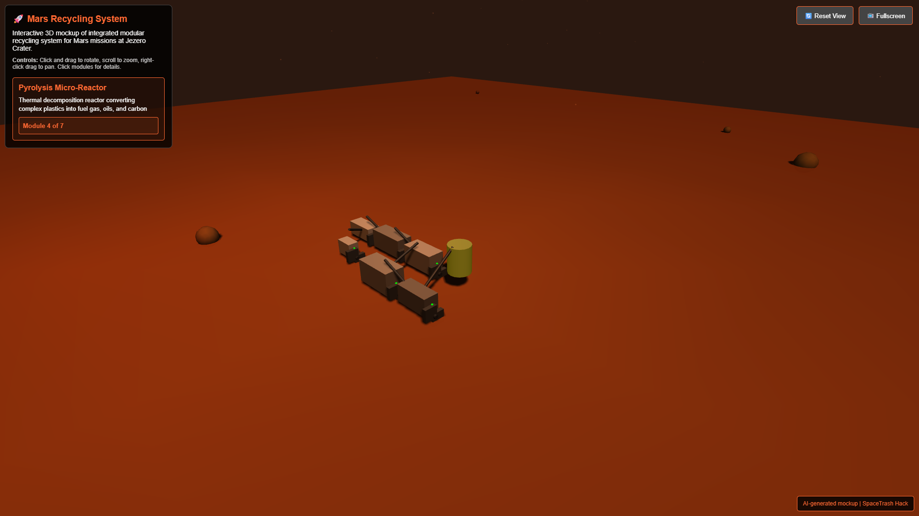


MARS MISSION // RECYCLING SYSTEMS
JEZERO CRATER · SOL 752 · MARS
Introduction: Recycling Challenges on Mars
Critical Challenge
WASTE ACCUMULATION SIMULATION
During a three-year Mars mission, an eight-person crew generates 12,600 kg of inorganic waste. With millions of miles between Mars and Earth, traditional waste management becomes impossible.
Key Constraints
No return option for waste materials
Limited space within habitats
Minimal energy and water resources
Harsh Martian environment (radiation, dust)
Solution Approach
Sustainable, integrated recycling systems that transform waste into valuable resources through innovative processing methods and modular design.
Integrated waste processing system concept for Jezero Crater Mars base
SPACETRASH HACK // OUR FUTURE HOME MARS
2/25

Slide 3
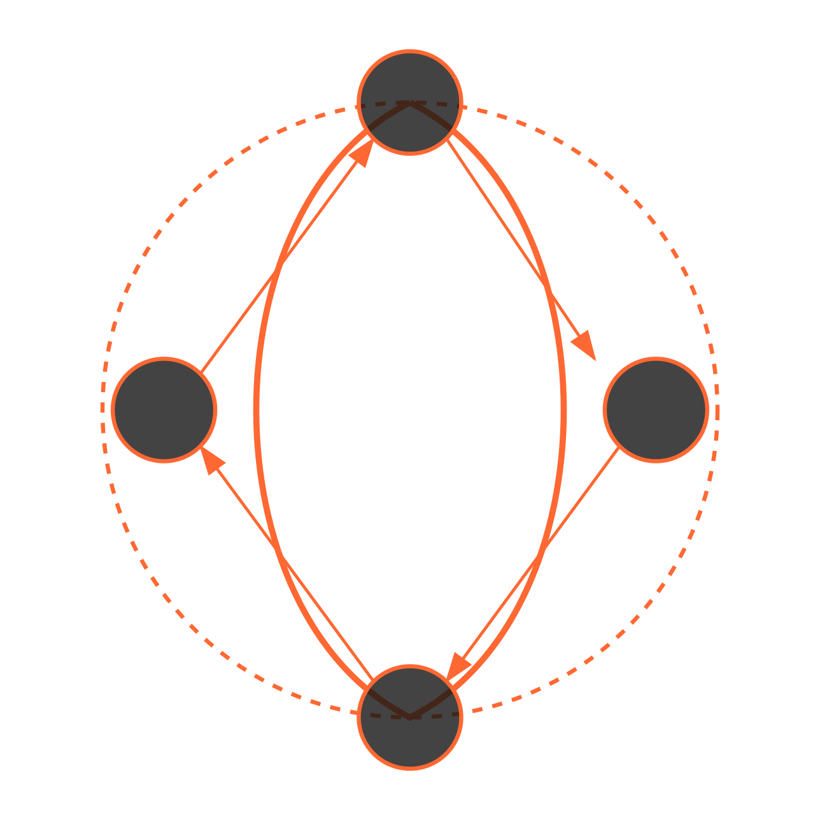



MARS MISSION // RECYCLING SYSTEMS
JEZERO CRATER · SOL 752 · MARS
Vision: Closing the Resource Loop on Mars
Sustainable Systems
CLOSED-LOOP RESOURCE MODEL
Our project envisions a fully integrated modular recycling system that transforms all waste streams into valuable resources, eliminating the concept of "trash" on Mars missions and establishing a foundation for long-term settlement.
WASTE
PRODUCTS
PROCESS
In-Situ Resource Utilization
Combine recycled materials with Martian regolith
Recover water and volatiles from waste streams
Generate partial energy from waste processing
Minimize reliance on Earth resupply missions
MATERIALS
Circular Economy
Every item brought to Mars has multiple life cycles through our system. Waste becomes raw material, which becomes new products, eventually returning to the recycling loop when their utility ends.
Sustainable circular resource flow for Mars habitation
SPACETRASH HACK // OUR FUTURE HOME MARS
3/25

Slide 4


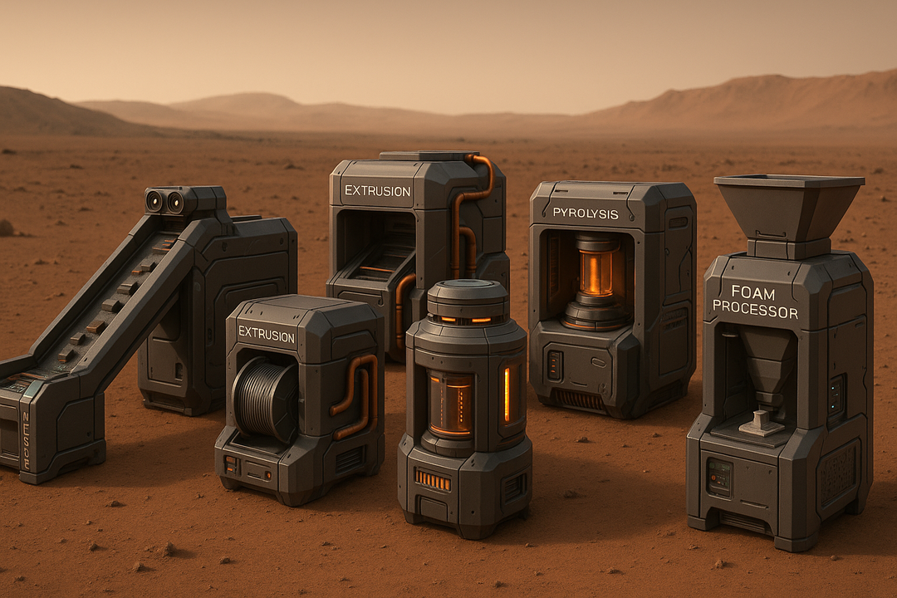

MARS MISSION // RECYCLING SYSTEMS
JEZERO CRATER · SOL 752 · MARS
System Overview: Integrated Modular Mars Recycling
Modular Architecture
SYSTEM ARCHITECTURE DIAGRAM
Our recycling system consists of six interconnected modules designed for versatility and redundancy. Each module functions independently while contributing to a unified recycling workflow.
Ai
Key System Features
Deployable inside or outside pressurized habitat
Power consumption: 1-3 kW peak with heat recovery
Semi-automated operation (1 crew member)
Minimal water requirements with recycling
Processes 5-10kg waste material per day
Integration Approach
Modules connect via standardized interfaces for material transfer, energy sharing, and telemetry. The system adapts to habitat layouts while maintaining a compact footprint (12m² total).
Modular Mars recycling system with sorting, shredding, extrusion, pyrolysis, 3D printing, and foam processing units
SPACETRASH HACK // OUR FUTURE HOME MARS
4/25

Slide 5



MARS MISSION // RECYCLING SYSTEMS
JEZERO CRATER · SOL 752 · MARS
Waste Streams: What Needs to be Recycled?
Primary Waste Streams
WASTE STREAM ANALYSIS
Based on NASA mission data, a Mars mission accumulates six major categories of non-metabolic waste:
Foam Packaging
EVA Waste
Fabrics
Food Packaging
Structural Elements
Other Packaging/Gloves
Foam Packaging
EVA Waste
Zotek F30 (100%)
Nomex (92%), Nylon (3%), Polyester (2%)
1000 kg / 10 m³
High-volume material with excellent insulation properties
100 kg / 1 m³
Cargo Transfer Bags with durable, flame-resistant materials
Structural Elements
Aluminum Structures (90%)
Polymer Matrix Composites (10%)
1000 kg / 10 m³
Carbon Fiber, Plastic Resin
Fabrics
Food Packaging
Other Packaging/Gloves
Cotton/Cellulose, Nylon, Polyester
Polyester, Polyethylene, Aluminum, Nylon
Plastazote (36%)
Air Cushions (4%)
1000 kg / 10 m³
Nitrile Gloves (41%)
Bubble Wrap, Bags (19%)
Clothing (77%), Towels (21%), Cleaning Wipes (2%)
1000 kg / 10 m³
100 kg / 1 m³ - Lowest mass but critical for operations
Overwrap (29%), Pouches (47%), Drink Containers (8%)
SPACETRASH HACK // OUR FUTURE HOME MARS
5/25

Slide 6

SYSTEM ARCHITECTURE // MODULAR RECYCLING
TECHNICAL DIAGRAM · MODULE FLOW · MARS
System Architecture Diagram
INTEGRATED WASTE RECYCLING SYSTEM
MARS BASE · JEZERO CRATER
1
2
3
4
Waste Input
Processing
Resource Recovery
Final Products
SPACETRASH HACK // OUR FUTURE HOME MARS
6/25

Slide 7

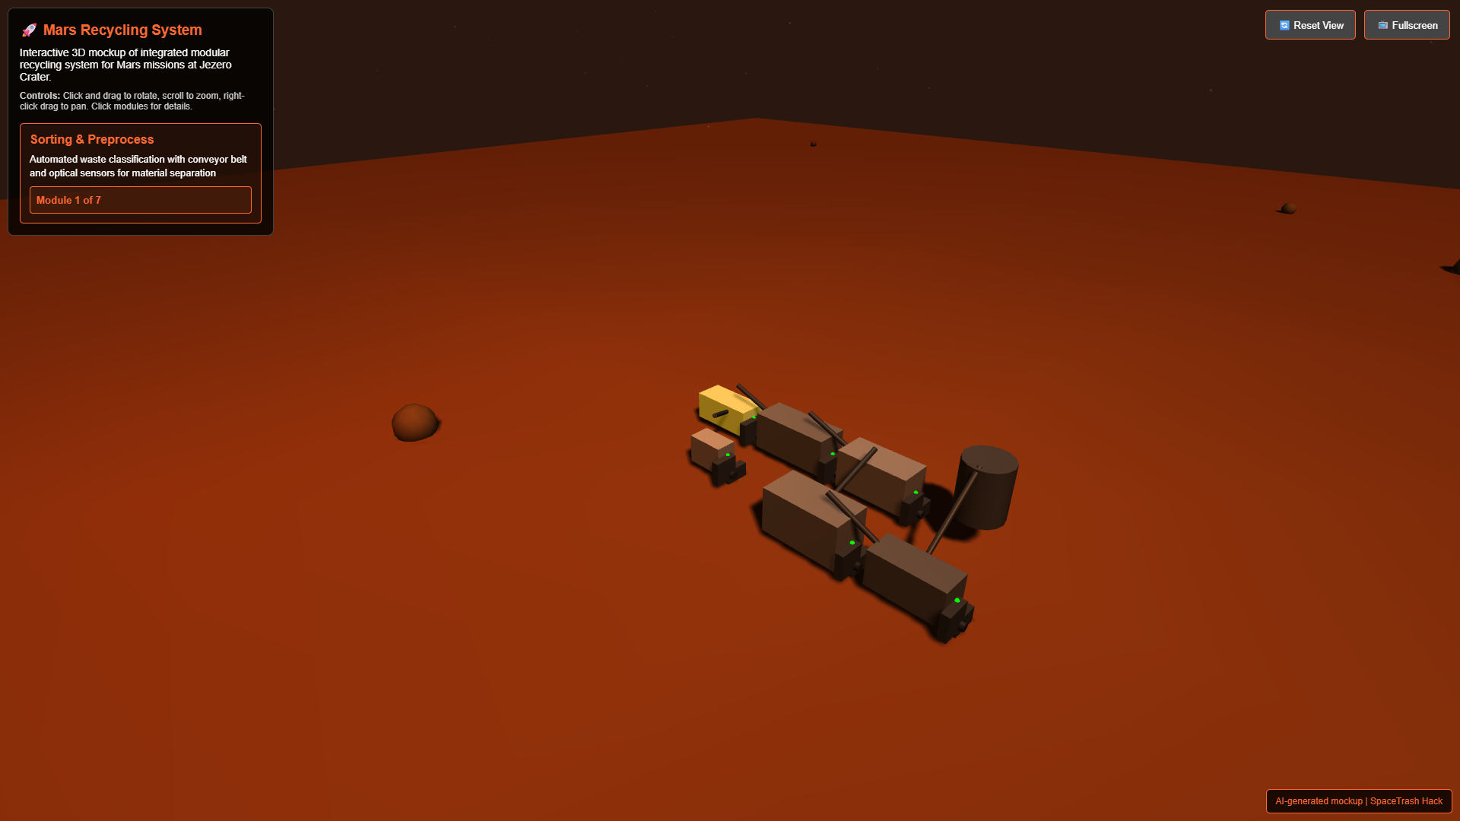


MARS MISSION // RECYCLING SYSTEMS
JEZERO CRATER · SOL 752 · MARS
Sorting & Preprocessing Module
Module Function
MODULE VISUALIZATION
The first stage in our recycling process: separates mixed waste into distinct material streams for optimal downstream processing. Uses sensor-based identification and manual/robotic sorting to maximize resource recovery.
Key Specifications
Processing capacity: 20kg/day
Power consumption: 0.2-0.5kW
Sorting accuracy: >95% with machine vision
Materials sorted: Plastics, foams, textiles, metals
Dimensions: 1.2m x 0.8m x 1.0m (foldable)
Sensor-equipped sorting conveyor with AI material recognition system
Integration Points
MATERIAL FLOW
Outputs clean material fractions to the Shredding & Drying module. Operates semi-automatically with one astronaut/robot operator per session. Collapsible design for transport and modular installation.
Plastics
Fabrics
Foams
Metals
Composite
1000 kg
600 kg
400 kg
300 kg
200 kg
SPACETRASH HACK // OUR FUTURE HOME MARS
7/25

Slide 8








MARS MISSION // RECYCLING SYSTEMS
JEZERO CRATER · SOL 752 · MARS
Shredding & Drying Module
SHREDDER/DRYER SCHEMATIC
Core Functions
Mechanical processing unit that reduces waste volume by 80-90% through precision shredding and moisture removal. Produces uniform feedstock for downstream processing.
Input Waste
Shredder
Dryer
Feedstock
Key Design Features
Technical Specifications
Dual-rotary cutting mechanism with hardened blades
Variable speed control for different material types
Vacuum-assisted moisture extraction system
Processing capacity: 2-5kg/hour
Heat recapture from motors for drying efficiency
Power usage: 0.4-0.7kW (peak)
Automatic sorting of metals/non-processables
Shred size: 3-5mm flakes/pellets
Heat recovery: 60% efficiency
Performance Metrics
Moisture removal: Up to 95% (fabrics)
90%
95%
0.2kWh
Volume Reduction
Moisture Removal
Per kg Processed
Material Compatibility
Plastics (PE, PP, PET)
Textiles/Fabrics
Composites (partial)
Thin Foams
Metals
Mixed Materials
Enhanced with vacuum-assisted drying system for water conservation
SPACETRASH HACK // OUR FUTURE HOME MARS
8/25

Slide 9
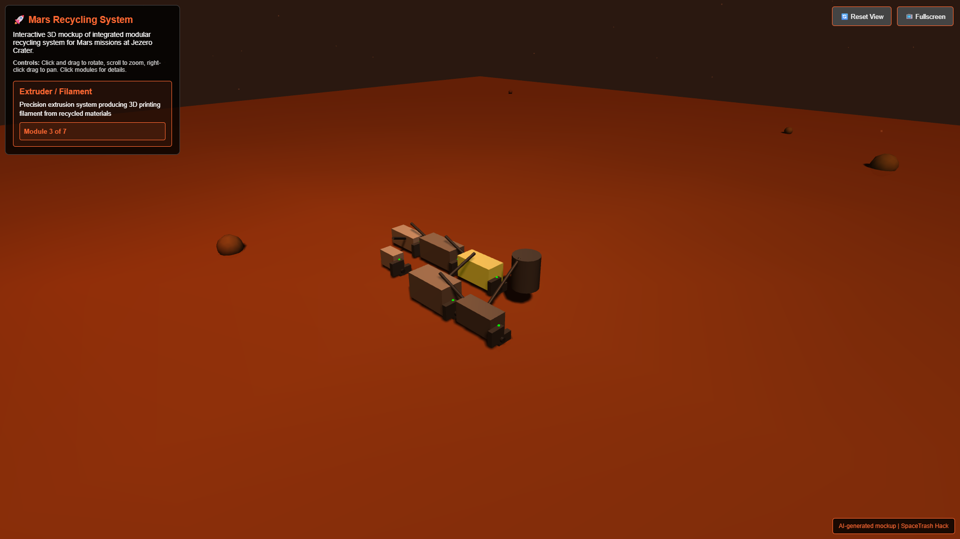

MARS MISSION // RECYCLING SYSTEMS
JEZERO CRATER · SOL 752 · MARS
Extrusion & Filament Production Module
Module Function
FILAMENT EXTRUSION PROCESS
Positrusion-inspired extruder that transforms clean plastic waste into high-quality 3D printing filament. Processes sorted polymer flakes from multiple waste categories into standardized filament spools ready for immediate use.
Technical Specifications
Power Usage: 400-650W peak
Processing Capacity: 0.5-0.8 kg/hr
Temperature Range: 160-320°C
Filament Diameters: 1.75mm & 2.85mm
Compatible Materials: HDPE, LDPE, PP, PET, Nylon, EVOH
System Benefits
Recycles food packaging & containers
Integrates thermal recovery with pyrolysis unit
Automated diameter control & quality monitoring
Variable color mixing for filament customization
SPACETRASH HACK // OUR FUTURE HOME MARS
Produces standardized filament from PET, HDPE, PP, and nylon waste materials
9/25

Slide 10






MARS MISSION // RECYCLING SYSTEMS
JEZERO CRATER · SOL 752 · MARS
Pyrolysis Micro-Reactor Module
Process Overview
PYROLYSIS PROCESS VISUALIZATION
Thermal decomposition chamber that processes mixed/complex plastics in low-oxygen conditions. Specialized for multilayer food packaging and composite materials that cannot be directly extruded.
Gas
Mixed Waste Input
Energy
Recovery
Loop
Technical Specifications
Heat Source
Operating Temperature: 400-600°C
Carbon
Capacity: 0.5-2 kg/hour
Power Usage: 0.8-1.5 kW
Oil/Wax
Thermal Recovery Efficiency: 65-70%
Gaseous Product Yield: 15-25%
Liquid/Wax Yield: 40-60%
Carbon/Char Yield: 20-30%
Output Utilization
25-30%
Gas: Redirected as heating fuel for other modules
65-70%
0.6-0.8 kW
Liquid/Wax: Used as binder or secondary fuel source
Thermal
Energy
System Mass
Carbon/Char: Filler for composite materials or conductive elements
Efficiency
Recovery
Reduction
Energy Recovery Performance
SPACETRASH HACK // OUR FUTURE HOME MARS
10/25

Slide 11



MARS MISSION // RECYCLING SYSTEMS
JEZERO CRATER · SOL 752 · MARS
Composite 3D Printing & Molding Station
Technology Overview
COMPOSITE MANUFACTURING SYSTEM
Advanced additive manufacturing system capable of combining recycled polymer filament with Mars regolith (MGS-1) to create high-strength composite parts and structural elements.
RECYCLEDFILAMENT
REGOLITHSTORAGE
Technical Specifications
Print volume: 300mm x 300mm x 250mm
HEATED BUILD PLATE
Resolution: 50-200 micron layer height
Regolith mix ratio: 30-70% (adjustable)
Heated build plate: up to 110°C
Nozzle temperature: up to 280°C
Power consumption: 400W peak
Output Products
Recycled filament from extrusion module feeds into printer
Tools: Wrenches, connectors, repair components
MGS-1 Mars regolith simulant mixed at optimal ratio (30-70%)
Composite material extruded in precise layers
Panels: Habitat dividers, radiation shields
Process Workflow:
Structural: Support beams, brackets, fixtures
Optional compression molding for larger structural elements
Molds: Custom form blocks for larger structures
Final curing enhances strength by up to 300% vs pure plastic
SPACETRASH HACK // OUR FUTURE HOME MARS
11/25

Slide 12
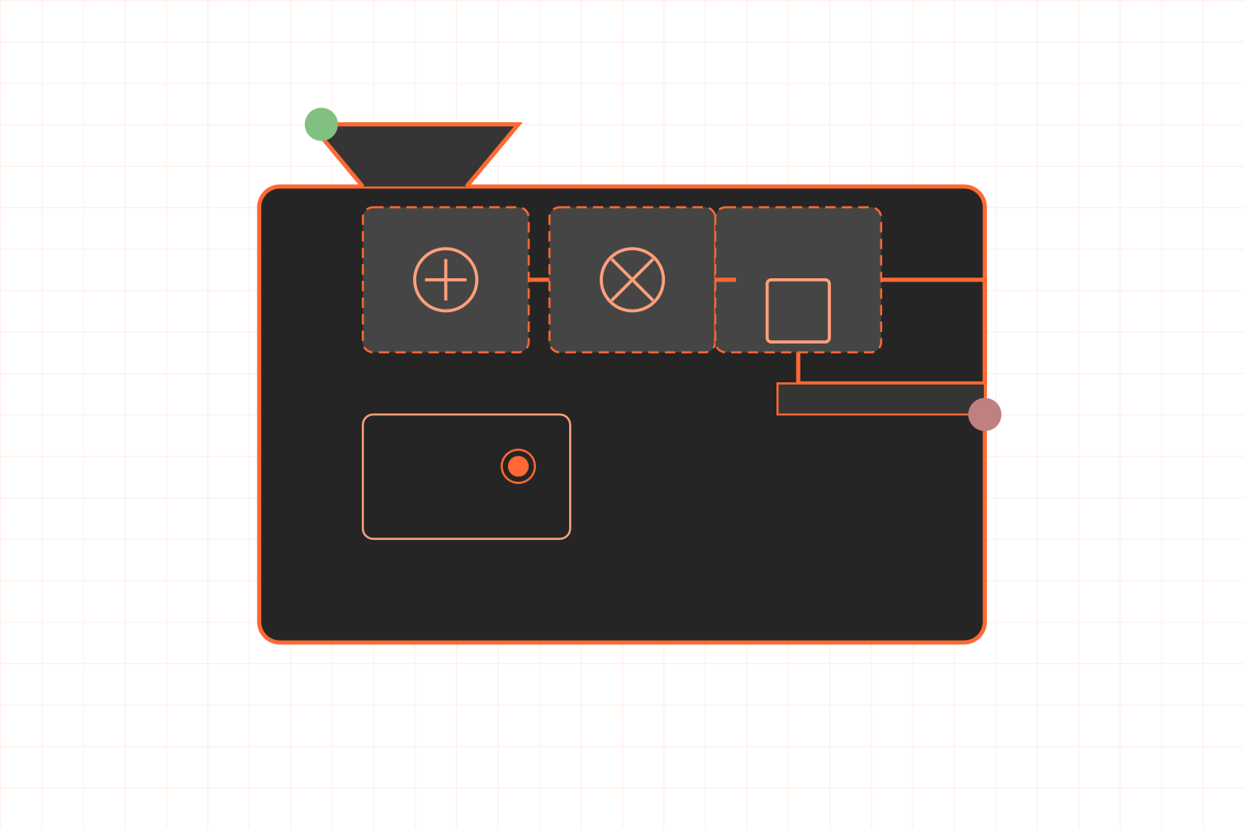

MARS MISSION // RECYCLING SYSTEMS
JEZERO CRATER · SOL 752 · MARS
Foam Packaging Processor Module
Process Overview
FOAM PROCESSOR CONFIGURATION
Transforms bulky foam waste (Zotek F30, Plastazote LD45 FR) into useful insulation materials, protective padding, and structural blocks through shredding, binding, and reforming processes.
RAW FOAM
INPUT
Technical Specifications
SHREDDER
BINDER
PRESS
Processing capacity: 20-50 kg/day (Zotek F30)
Volume reduction: 60-80% of original packaging
Power usage: 0.3-0.7 kW during operation
OUTPUT
PROCESSED
Thermal binding option using pyrolysis byproducts
CONTROL UI
Cold-press capability for non-melting foams
Key Outputs
Thermal insulation panels (R-value: 5.2/inch)
Impact-absorbing padding for equipment
Moisture-resistant packaging for samples
Acoustic damping materials for habitat zones
Schematic of Foam Processor transforming Zotek F30 packaging into usable products
Structural filler for composite components
SPACETRASH HACK // OUR FUTURE HOME MARS
12/25

Slide 13



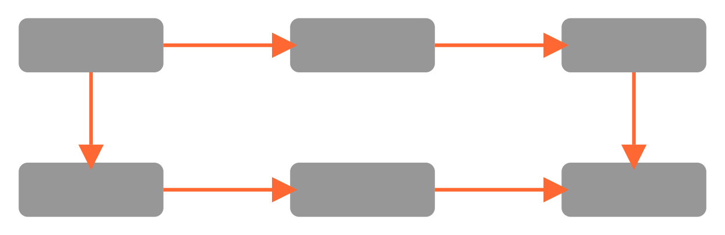



MARS MISSION // RECYCLING SYSTEMS
JEZERO CRATER · SOL 752 · MARS
Control Interface & Telemetry
System Overview
CONTROL INTERFACE VISUALIZATION
MODULE STATUS
ENERGY USAGE
Centralized monitoring and control system that integrates all recycling modules through a unified interface. Provides real-time data visualization, predictive maintenance alerts, and resource utilization tracking.
Sorter
Shredder
Extruder
3D Printer
1.24 kW / 2.0 kW
Pyrolysis
Foam
PROCESS FLOW VISUALIZATION
SORTING
SHREDDING
EXTRUSION
Key Performance Metrics
Process throughput: 5-25 kg/day
Energy consumption monitoring (±0.1 kW)
PYROLYSIS
3D PRINTING
OUTPUT
Temperature control (±2°C precision)
System pressure monitoring (±5 kPa)
Material composition analysis
ACTIVE ALERTS
Real-time yield calculations
Pyrolysis temperature approaching threshold
Technical Specifications
Filament production optimal
10.1" ruggedized touchscreen interface
Foam processor at 82% efficiency
Semi-automated operation modes
Power draw: 45-120W (operational)
No other active alerts
Embedded fault detection algorithms
Interface supports both manual and autonomous control modes with haptic feedback and voice command options
Wireless mesh network connectivity
Data storage: 500 TB solid-state memory
SPACETRASH HACK // OUR FUTURE HOME MARS
13/25

Slide 14
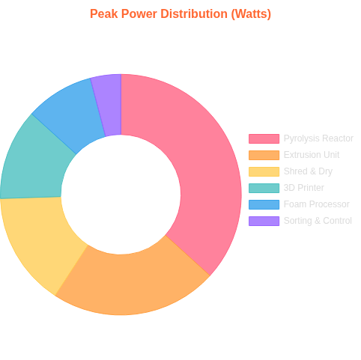

MARS MISSION // RECYCLING SYSTEMS
JEZERO CRATER · SOL 752 · MARS
Technical Specifications: Energy Requirements
System Power Overview
ENERGY ALLOCATION & THERMAL RECOVERY
Total peak power: 1-3 kW
Nominal operation: 850W average
Standby power draw: 150W
Habitat power integration via standard 48V DC connections
Module-Specific Requirements
Module
Peak Power
Operation Time
Sorting & Preprocess
120W
Continuous
Shred & Dry
750W
15-30 min/batch
Extrusion Unit
1100W
40-60 min/batch
Pyrolysis Reactor
1800W
2-3 hrs/batch
3D Printer/Molder
600W
Variable
Foam Processor
450W
30-45 min/batch
Control System
80W
Continuous
35% of total energy
75% solar-powered
Heat Recovery
8 hour runtime @ 500W
SPACETRASH HACK // OUR FUTURE HOME MARS
Energy recovery and distribution diagram for Mars Recycling System
14/25
Solar Integration
Battery Backup

Slide 15







MARS MISSION // RECYCLING SYSTEMS
JEZERO CRATER · SOL 752 · MARS
Technical Specifications: Water & Crew Requirements
Water Consumption
Crew Operations
Sorting & Preprocessing
0.2 L/kg waste
Module
Operator Hours/Week
Automation Level
Shredding & Drying
0.5 L/kg waste
Sorting & Preprocessing
4.5 hours
●●●○○
Extrusion Process
0.3 L/kg plastic
3D Printing & Cooling
0.4 L/kg product
Shredding & Drying
2.0 hours
●●●●○
Extrusion & Filament
1.5 hours
●●●●●
Water Conservation Strategies
Pyrolysis Reactor
3.0 hours
●●●●○
Closed-loop reclamation (95% recovery)
3D Printing & Foam
5.0 hours
●●●○○
Optional dry-cleaning for textiles
Condensation collection from drying process
Robotic Sorting
AI Process Control
System Expansion Options
Minimal-moisture foam processing
Reduces crew time by 75%
Improves yield by 15%
Solar Integration
ISRU Integration
Reduces energy needs
Local resource use
SPACETRASH HACK // OUR FUTURE HOME MARS
15/25

Slide 16

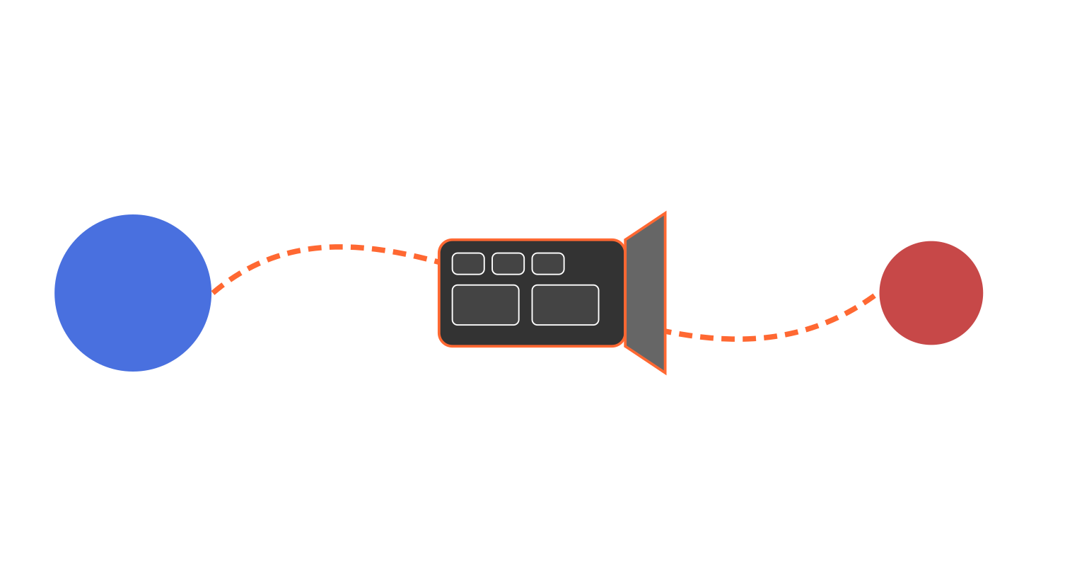


MARS MISSION // LOGISTICS & TRANSPORT
JEZERO CRATER · SOL 752 · MARS
Transport: Modular Packaging for Mars Delivery
Modular Design Approach
MODULAR TRANSPORT CONFIGURATION
Compact, collapsible modules reduce launch volume by 65%
Lightweight alloy frame components (78% mass reduction)
Nesting design for belts, hoppers, and collection bins
Multi-functional components serve dual roles in transit and operation
EARTH
MARS
Launch & Transit Protection
Custom shock-absorbing frames for sensitive components
Thermal insulation for electronic components
Vacuum-rated seals and connectors
Radiation shielding for control systems and UI components
MODULE
PACKED VOL.
TRANSPORT SPECIFICATIONS
MASS
ASSEMBLY TIME
Packaging Reusability
Sorting Unit
0.8m³
120kg
45min
Transport packaging containers convert into habitat storage units, workbenches, and protective enclosures - applying "Logistics-2-Living" principles for maximum resource utilization.
Processing Core
1.2m³
180kg
90min
3D Print Station
0.6m³
95kg
30min
Control Interface
0.3m³
45kg
20min
SPACETRASH HACK // OUR FUTURE HOME MARS
16/25

Slide 17
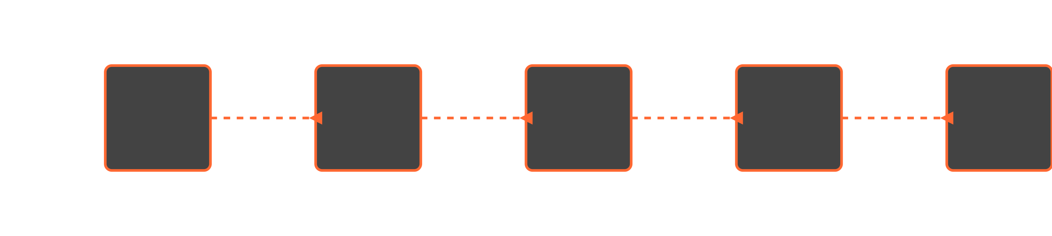
ASSEMBLY & INTEGRATION // DEPLOYMENT SEQUENCE
OPERATIONAL PROTOCOL · MARS BASE · JEZERO CRATER
Assembly & Integration on Mars
1
2
3
4
5
MODULAR SYSTEM DEPLOYMENT
ASSEMBLY TIMELINE: 8-12 HOURS
UNPACK
POSITION
ASSEMBLE
CONNECT
CALIBRATE
Modules unpacked from transport vessel with robotic assistance
Transport to designated habitat location on stable surface
Connect modular components following deployment sequence protocol
Establish power, data, and material transfer interfaces between modules
Test systems and initialize operational parameters
PACKED MODULES
SURFACETR ANSPORT
MODULAR CONNECTION
SYSTEM INTEGRATION
OPERATIONAL READINESS
Assembly conducted within pressurized habitat or with EVA suits in controlled conditions
2 crew members minimum, aided by robotic assistants for heavy lifting and precision alignment
All systems undergo sequential validation checks before final operational approval
ENVIRONMENT CONTROL
CREW REQUIREMENTS
VERIFICATION
SPACETRASH HACK // OUR FUTURE HOME MARS
17/25

Slide 18
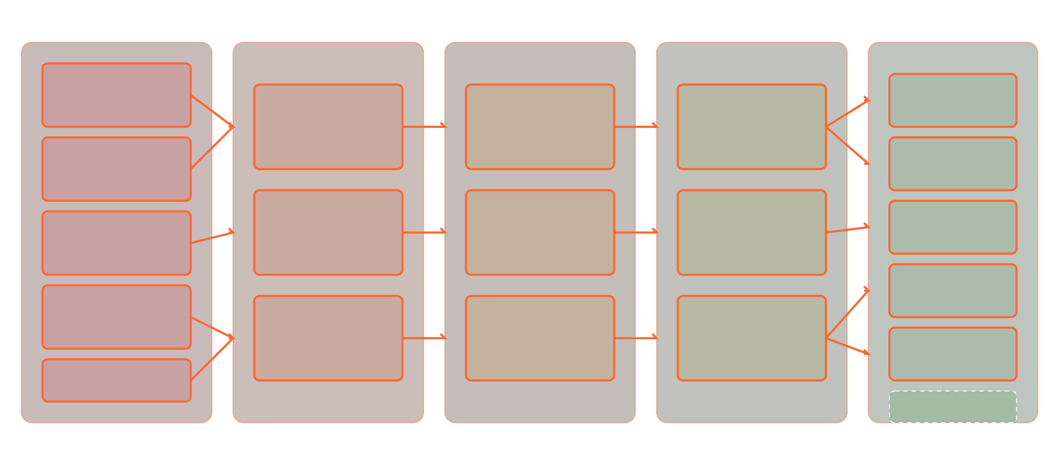
SYSTEM WORKFLOW // PROCESS VISUALIZATION
END-TO-END PROCESS · MATERIAL FLOW · MARS
System Workflow: End-to-End Process
WASTE TO RESOURCE TRANSFORMATION
CIRCULAR ECONOMY FLOW
WASTE INPUT
PREPROCESSING
PROCESSING
MANUFACTURING
FINAL PRODUCTS
Fabric Waste
Tools & Parts
Sorting &Preprocessing
Extrusion &Filament Production
Composite 3D Printing
Food Packaging
Construction Materials
Shredding &Drying
Pyrolysis Micro-Reactor
Insulation
Structural Elements
Molding &Forming
Energy Source
Foam Packaging
Material Segregation
Foam Processor
Energy Recovery
Habitat Elements
Other Materials
Zero Waste Goal
SPACETRASH HACK // OUR FUTURE HOME MARS
18/25

Slide 19







MARS MISSION // RECYCLING SYSTEMS
JEZERO CRATER · SOL 752 · MARS
End Products: What Do We Make?
Manufacturing Materials
RECYCLED PRODUCT CATALOG
Recycled Filament: Multiple polymer types for 3D printing (PLA, PETG)
Waste Input
Carbon Residue: Filler material from pyrolysis for composites
12,600 kg/mission
Regolith Composites: Mixed with recycled plastics for enhanced strength
Filament
Energy
Tools
40% recovery
15% recovery
25% recovery
Functional Products
Tools & Parts: 3D printed repair components, utensils, containers
Insulation
Furnishings
15% recovery
5% recovery
Structural Elements: Panels, connectors, brackets, supports
Habitat Enhancements: Furniture inserts, storage solutions
Resource Recovery Rate
92-98%
Secondary Outputs
Minimal non-recyclable waste
Thermal Protection: Reprocessed foam insulation panels
Energy Recovery: Pyrolysis gas for heating systems
Binder Materials: Wax/oils for composite manufacturing
SPACETRASH HACK // OUR FUTURE HOME MARS
19/25

Slide 20




MARS MISSION // RECYCLING SYSTEMS
JEZERO CRATER · SOL 752 · MARS
Use Cases: Living and Working on Mars
Habitat Maintenance & Expansion
RECYCLED PRODUCTS IN USE
Recycled filament for 3D printing of connector fittings
Composite panels for partition walls and workspace dividers
Habitat Utilization Rate
Foam-based insulation for thermal regulation
3D Printed Components - 87%
Regolith-polymer composite blocks for external structures
Foam Insulation - 65%
Tools & Equipment - 92%
Tools & Equipment
Custom-fabricated repair tools and spare parts
Storage containers from reformed plastics
IMPLEMENTATION HIGHLIGHTS
Science equipment housings and sample containers
Emergency Repairs
Radiation Protection
EVA tool attachments and utility holders
On-demand production of critical replacement parts reduced downtime by 78%
Layered foam shields reduce radiation exposure by 42% in rest areas
Health & Safety Improvements
Additional radiation shielding using processed foam layers
Ergonomic workstation components and seating
Thermal Efficiency
Habitat Expansion
Emergency repair kits from pyrolysis carbon composites
Composite insulation improves habitat energy efficiency by 35%
Modular panels enable 250m² of additional usable space
Medical splints and supportive devices
SPACETRASH HACK // OUR FUTURE HOME MARS
20/25

Slide 21



MARS MISSION // RECYCLING SYSTEMS
JEZERO CRATER · SOL 752 · MARS
System Impact Assessment
Resource Savings
SUSTAINABILITY METRICS
Mass Reduction: 12,600 kg recovered for 8-person crew over 3 years
Waste Reduction & Resource Recovery
Volume Optimization: 40% habitat space recovery
Energy Recovery: 15-20% energy recapture via pyrolysis
Water Conservation: 98% recycling efficiency with minimal processing water
Environmental Impact Rating
Mission Enablement
92%
Extended mission duration by up to 30%
Superior to standard waste disposal methods by 92%
Enhanced habitat sustainability and self-sufficiency
Long-term ROI Analysis
Improved crew safety through rapid parts manufacturing
Reduced dependency on resupply missions
4x
6x
8x
Testing ground for circular economy principles for future settlements
Resource
Mission
Long-term
Utilization
Extension
Value
SPACETRASH HACK // OUR FUTURE HOME MARS
21/25

Slide 22
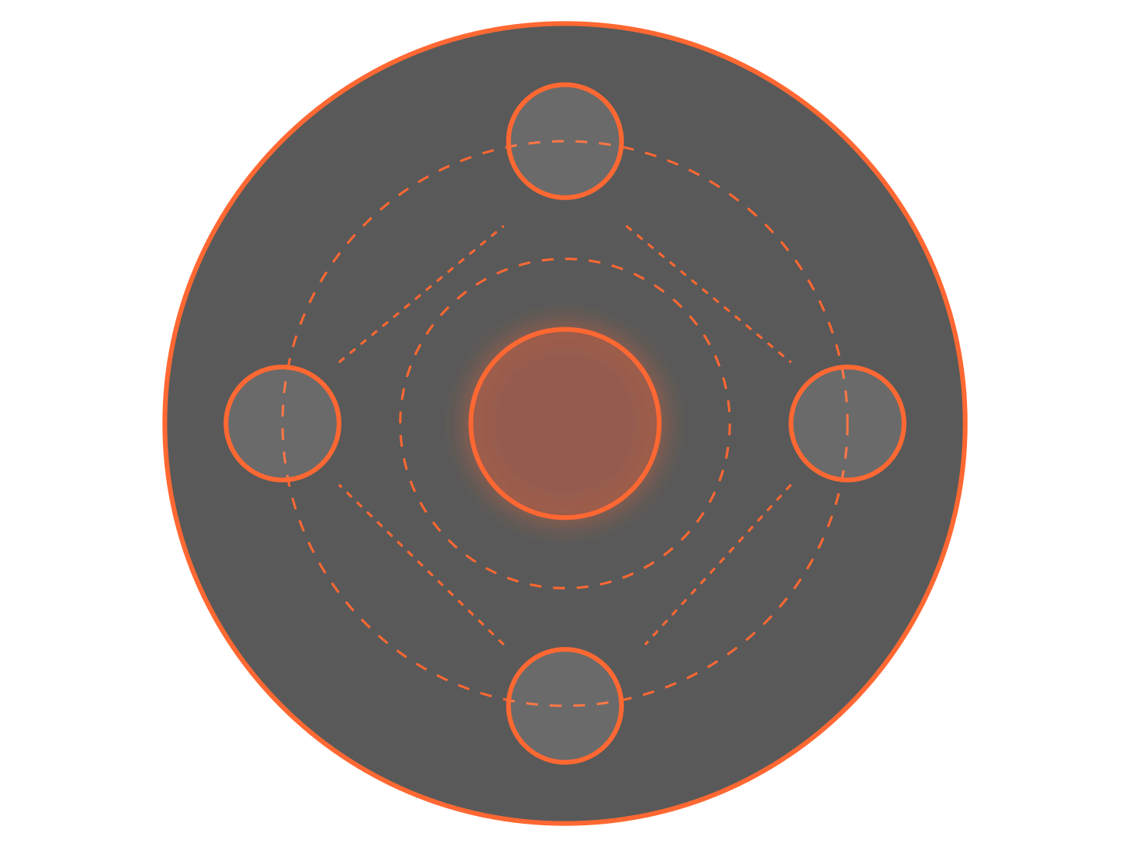


MARS MISSION // RECYCLING SYSTEMS
JEZERO CRATER · FUTURE PHASE · MARS
Futuristic Expansion: Toward Full Circular Economy
Colony-Scale Recycling
FUTURE EXPANSION ROADMAP
As Mars settlements grow from initial habitats to full colonies, recycling systems will scale proportionally, integrating multiple processing modules into networked hubs that can handle increasing waste volumes.
CURRENT SYSTEM
FULLISRU
CIRCULAR
ECONOMY
automated network
Advanced Automation
AI-powered sorting with machine vision
Robotic handling of hazardous materials
Self-optimizing pyrolysis parameters
COLONY SCALE
Predictive maintenance algorithms
Integration with ISRU
Future systems will fully integrate with In-Situ Resource Utilization, combining recycled materials with Martian resources to create a completely self-sustaining material ecosystem for construction, manufacturing, and life support.
Digital twin technology will track all materials from arrival on Mars through multiple recycling lifecycles, optimizing resource allocation and preventing waste accumulation.
Smart Material Tracking
SPACETRASH HACK // OUR FUTURE HOME MARS
22/25

Slide 23



MARS MISSION // RECYCLING SYSTEMS
JEZERO CRATER · SOL 752 · MARS
Conclusion: Shaping the Future of Mars Habitats
Key Achievements
MARS HABITAT PROJECTION
Our integrated modular recycling system creates a sustainable closed-loop resource recovery platform essential for long-duration Mars missions.
Beyond Recycling: A New Path Forward
Our recycling system is just the beginning of a new era where waste doesn't exist—only resources waiting to be transformed.
System Impact
Reduces waste mass by up to 95%
Generates valuable resources from "trash"
Enables habitat expansion with local materials
Sustainable Living
Technological Innovation
Human Resilience
Provides energy recovery and reuse
"The first sustainable settlement beyond Earth will be built not just with materials shipped from our home planet, but with resourcefulness, innovation, and our ability to see value where others see waste."
Our Vision
By transforming waste into resources, we're not just solving a logistics problem—we're establishing the foundation for humanity's sustainable presence on another world. What we learn from Mars will improve sustainability practices on Earth.
SPACETRASH HACK // OUR FUTURE HOME MARS
23/25

Slide 24

REFERENCES // SOURCES & ACKNOWLEDGEMENTS
SPACETRASH HACK · 2025 · MARS
References
NASA Resources
Academic & Technical Papers
NASA Space Apps Challenge (2025) SpaceTrash Hack: Revolutionizing Recycling on Mars https://www.spaceappschallenge.org/2025/challenges/
Howe, A. S., & Howard, R. (2010) Dual use of packaging on the moon: Logistics-2-Living AIAA 40th International Conference on Environmental Systems
NASA Technical Reports Server (2024) Waste Materials Recycling for In-Space Manufacturing Document ID: 20240004496
Cannon, K. M., et al. (2019) Mars Global Simulant MGS-1: A Rocknest-based Open Standard for Basaltic Martian Regolith Simulants Icarus, 317, 470-478
NASA/JPL (2022) Perseverance Explores the Jezero Crater Delta NASA ID: JPL-20220906
ScienceDirect (2024) Pyrolysis reactor design and thermal energy recovery systems for space applications Journal of Aerospace Engineering
Additional Resources
Acknowledgements
Mars Facts (2025) Basic information on the planet Mars: structure, atmosphere, size, and more NASA Mars Exploration Program
We would like to thank the NASA Space Apps Challenge organizers, mentors, and fellow participants for their support and inspiration. Special thanks to the scientists and engineers at NASA and JPL whose research and innovations in Mars exploration make this project possible.
Non-Metabolic Waste Categories (2024) Tables of waste streams, material makeups, and commercial equivalents NASA Space Technology Mission Directorate
SPACETRASH HACK // OUR FUTURE HOME MARS
24/25

Slide 25





THANK YOU // Q&A SESSION
SPACETRASH HACK · 2025 · MARS
Thank You!
Our Team
Connect With Us
Our Future Home Mars
khion2002@gmail.com Lujainmahdi614@gmail.com
2025 NASA Space Apps Challenge
from Iraq, Baghdad
Khayoon Alaayedi
Leader, Aerospace and Drone Engineer
Questions?
Lujain Mahdi Siham
We welcome your questions about our Mars recycling system design and implementation details.
Researcher, Energy Engineer
So when you think of our project, don't just think of it as taking out the trash. Think of it as the system that will print the spare part that saves the mission, the system that turns every piece of waste into a tracked asset, and the system that lays the foundation not just for living on Mars, but for thriving there.
Q&A SESSION NOW OPEN
"To transform space waste into valuable resources, enabling sustainable human presence on Mars through innovative recycling technologies that close the loop on resource utilization."
SPACETRASH HACK // OUR FUTURE HOME MARS
25/25

